Slide 1
Video Games as Museum Interpretive Tools:
A Preliminary Look
KT Lowe, University of Michigan
Graduate Certificate in Museum Studies 2011
MSI, Preservation of Information 2011
BA, Asian Studies 2008
Lowe
Notes:
Start by asking about the “average gamer”. Poll the audience to ask about favorite games. Note that each of these games has a lot of the same elements – players and purpose.

Slide 2
What’s a game?
“To play a game is to experience a system”
(Ian Bogost)
Games represent “a function of the ideas of those who think about them”
(Brian Sutton-Smith)
“A particular way of looking at something, anything” (Clark C. Abt)
Notes:
Video games possess the four main components of most systems: They have objects, which may or may not include the players themselves; they have qualities peculiar to the game itself; there are logical relationships among all the objects in the game; and they exist in an environment which has an impact on the game. In a museum context, this is a particularly prescient idea, which we’ll expand on later.
Games are not merely entertainment, however. Games are the product of human minds, an imagined landscape in which people choose to participate. Gameplay itself forges a contract between the game and the gameplayer. If the player continues to play, that means the ideas of the game creator are validated with each play, and the gamer agrees that the game makes sense. The ideas of the game designer are part and parcel of the game experience as a result. You can’t have a game in that sense without someone holding the strings. (Monopoly was designed by just such a feller.)
Abt’s take is probably the most intriguing for our purposes. A game is a pathway into interacting with a subject in a manner that most likely would be impossible otherwise. Now let’s think about museums, the temple of the untouchable object. Museums preserve objects – they’re in a case or in storage, away from light and moisture and usually away from the public eye. A game, while creating a set framework for interacting and understanding an object, is useful for allowing access to objects and presenting a particular understanding of what they are and why they’re important. A video game, therefore, allows visitors a unique, interactive experience with objects they wouldn’t normally be able to work with.

Slide 3
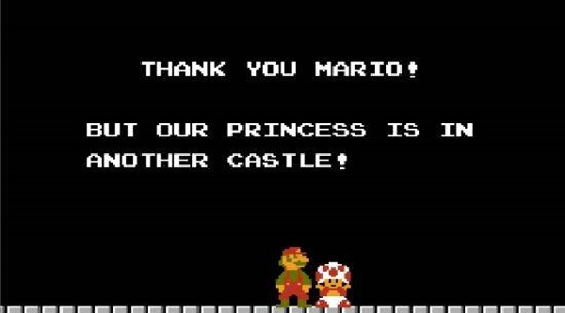
What’s a video game?
Displayed on a video device
Need not be entirely self-contained, and may include real-life objects and outcomes
Includes an overall goal/purpose with a series of smaller steps to attain that goal
Notes:
Much research has been done to ascertain what, in fact, a video game is.
The fact that it’s played on a video device sounds like something from the Captain Obvious department, but it’s not. The fact that it’s played on a screen defines at least some of the environment and interaction of the game. The gaming device helps shape the actions of the players and provides a method for giving and receiving commands. Unlike a board game, a video device can provide elaborate, animated feedback, and mobile video games in particular can incorporate both real-world and video-based objects. The game itself can expand beyond the device to take in the user’s entire experience.
Museums are based on narratives – each object in the museum includes a backstory that museum professionals tease out and make real for visitors. Video games also contain a narrative structure, and therefore the expected behavior and outcomes for visitors should not be too different from that already exhibited. When a video game creates an immersive world, it usually keeps the action entirely within the framework of the game. But let’s take as an example a game developed by the Smithsonian, “Ghosts of a Chance”. This game was designed to function as an alternative reality game – the computer framework provided
Game design is a new branch of study, and it is focused on both the visual design and the intellectual framework of the game. According to Salen and Zimmerman, gameplay is a series of cause/effect pairs: every decision, or move, made by the player returns a response from the game. These decisions, however must lead to meaningful outcomes – the players need to care about what happens or else the game is over. The play has to be engaging, the story has to be compelling (at least on the surface) and the challenges in the game must be solvable and progress in difficulty, with some kind of tangible result (if you hit a spaceship, it blows up). In addition, all actions play into the final outcome of the game.

Slide 4

Internship at the DIA
Preliminary research on how games would help the DIA with outreach
What kinds of games had already been designed for museums
Assessing the DIA’s current database structure to see if games would make sense for them now and in the future
Brainstorm ideas as to how it might work

Slide 5
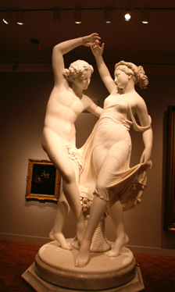
The Detroit Institute of Arts
One of the great American art institutions, with over 125 years of history and a collection of over 60,000 objects spanning close to 8000 years
Serves a diverse public, with about 40% of its audience made of school touring groups
Suffering major budget cutbacks due to dwindling state support and losses to the Museum’s endowment
Notes:
The DIA was founded in 1885 and celebrated its 125th anniversary last year. It conducts a series of public programs to both urban and suburban audiences, including day camps, art projects that can be completed in a single visit and outreach to the disabled. It offers a number of different types of school tours, specifically traditional ones based on art historical concepts and others which use Visual Thinking Strategies as a critical thinking exercise.
Like all institutions, the Museum has experienced a series of financial setbacks that have cut into the offerings that it can undertake. Yet the DIA, in its mission to “create experiences that help each visitor find personal meaning in art”, continues to seek innovative, exciting avenues into the minds of their public. Video games are an excellent solution, since adding video games acknowledges the reality of the average gamer and creates additional opportunities for visitors to explore and understand art.
What the museum needed was some basic ideas as to what kind of games would work with the institution,

Slide 6
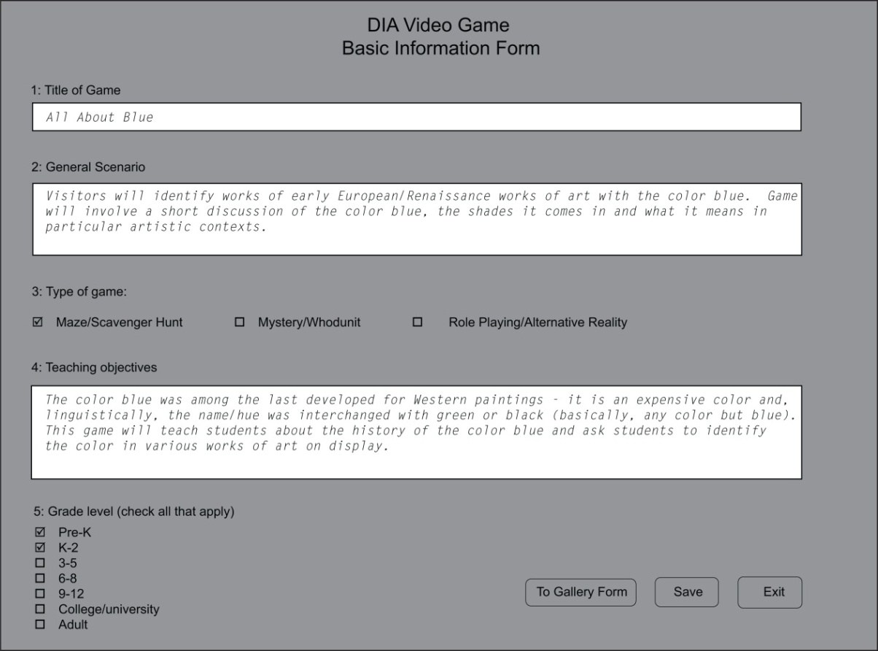
The long-term idea
Keep it simple for everyone involved.
Notes:
The DIA does not have a single game expert on its staff – this is hardly unusual, since most museums don’t generally require an in-house game designer. But if the average gamer is 37 years old and plays about an hour or so a day, and if 60% of the US population consists of regular gamers, then it would be surprising if the DIA did not have a single employee unfamiliar with games. This of course is absurd, and we can safely assume that there is a coterie of individuals who would be familiar enough with game play to work with a team to develop a custom interface to create in-house video games.
This would be an introductory framework in which the elements of a game would be inserted. The gameplay itself may be fairly generic in design, but a well-developed narrative would compensate. Narrative is key, as Warren Spector noted in 2004.
Let’s think about basic gameplay. It involves an explicit contract with the gamer and the game developer – a set of rules are established by the game, and the game player agrees to them by playing the game. Games are immersive, flexible and interdisciplinary by design: we incorporate all our senses, many of our skills (including spatial reasoning, manual dexterity and narrative development) and a great deal of personal knowledge when playing games. Far from idle entertainment, games are poised to be a major tool for education in the next few years.
Our games therefore must include basic information known only to us and other information made explicit to the player.

Slide 7
The long-term idea
What all games should permit:
  Linking to objects and their attendant label copy
  Mobility from platform to platform (i.e. from cell phone to iPad)
  An attractive, easy to use GUI for visitors
Why games?
  People learn better from games
  Games can allow for greater interactivity between themselves and the collection
  Games allow visitors to act in ways they would not otherwise
  Games make people better
Notes:
Ease of use will be the thorny part here. “Simple” and “easy” aren’t synonyms. But what we’re aiming for is a reusable framework that permits customization on the curatorial or L&I end. The backend will be the same, the data input screen we saw in the last slide. The front end, however, while basic, may include customizable elements such as color, question or puzzle format and avatars. This interface should be customized in a way that it signals to the game player what to do next or how to proceed. In that way, it’s a little like poetry.

Slide 8
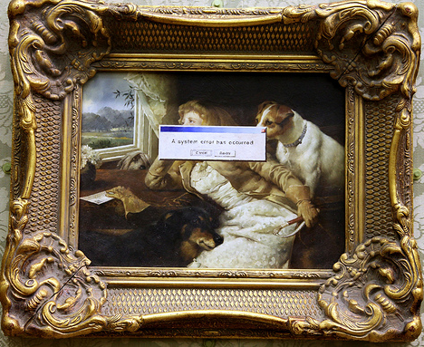
Games in Museums
Museums contain all the components of a system
  Objects
  Specific qualities
  Logical, meaningful relationships
  Environment
Notes:
I derive this list from Katie Salen and Eric Zimmerman’s excellent book Rules of Play. Museums are experiential at their core and must be considered in that context. Here, the objects are probably the most obvious component – they are on display and taken out of their original contexts.
The museum itself comprises specific qualities not gained elsewhere – the aura is alive and well, and Walter Benjamin can continue to rest peacefully. The original object is ostensibly only available in the museum, and no digital replicant to date appears to manage the same experiential pull of the original, even if the digital object can be manipulated in ways an original cannot.
Third, we have already established a relationship of our own with the museum. We as visitors expect a particular experience when we go, and we anticipate that we will have a guided contact with the objects. But the objects themselves are placed in galleries which allow the objects to maintain a relationship with each other, and these relationships are often defined by a curator through panel text.
Fourth and last, the museum itself is a unique environment. Museums are designed for the preservation and exhibition of objects, and often are constructed to heighten the awareness of its role as a public building.
Video games work along similar parallels and visitor behavior may coincide quite nicely with the expected behaviors of games. Unlike games, however, where the designer

Slide 9
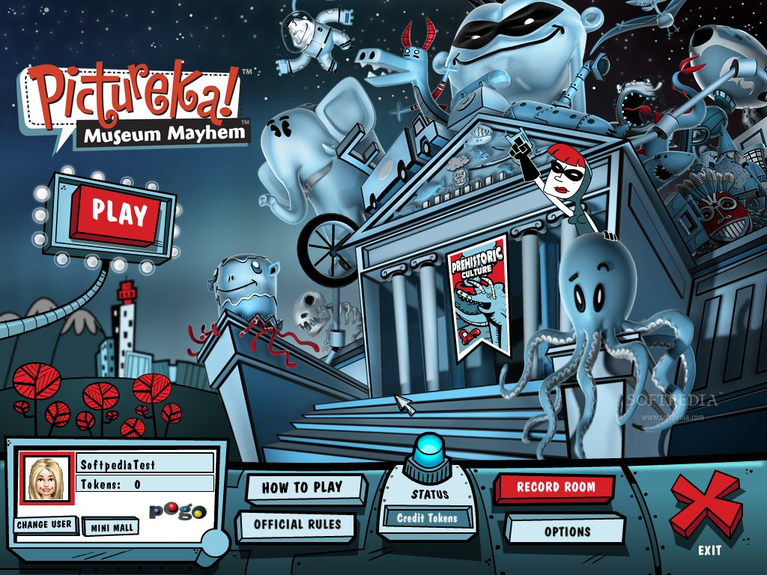
Some examples
Ghosts of a Chance, Smithsonian
Operation Sigismund, Waag Society (the Netherlands)
In-house kiosks at Shedd Aquarium, Chicago Museum of Science and Industry (You! The Experience)
Room of Wonders, Frame Museum (France)
Notes:
The use of video games as interpretative devices is nothing new. The use of video games for educational purposes dates to the beginning of video games, with the initial version of the well-known history game The Oregon Trail first conceived in 1975. Other games such as Where in the World is Carmen Sandiego and less-directly educational simulators have transcended their original contexts and have become incredibly popular on a general level. More and more museums, including the Getty Villa, have also incorporated video games into their interpretation. http://meaningfulplay.msu.edu/program.php?session=111
Museums themselves have been getting in on the action for about twenty years, with the earliest museum-based video games dating to about 1991.
The FRAME model http://www.kahnplus.com/en/work/case_frame.htm – excellent use of 3d modelling and a combination of gameplay techniques

Slide 10


The long-term idea
Game manufacturers:
  SCVNGR (pronounced “scavenger”)
“Scripted game system”
  Distilling the story told by the game into its basic components and presenting them
The “discernible” game
  Does the visitor know what to do?
  Do all actions lead to tangible results?
Notes:
SCVNGR uses RFID tags to track objects as part of a scavenger hunt. When an object’s tag is photographed, a challenge appears on the game interface (in this case, a cell phone). Once the challenge is fulfilled, then the next object can be sought and another challenge performed. Rewards include coupons, free items and other small rewards. This is similar to something we could conceive of rather easily, and gameplay follows expectations of game players: a quest to find the right tag, a reward when the right tag is found and a new challenge assigned.
The use of RFID tags would allow visitors to access label copy as found on our website – a process facilitated by a database upgrade! This kind of access would give us tremendous flexibility in designing games in conjunction with our website and permit full integration with objects.
Two types of games here that we can work with, both in terms of thinking of the museum as experience: The scripted game, which is more of a narrative style framework, and the discernible game in which player skill plays a major role in how the game will be played.

Slide 11
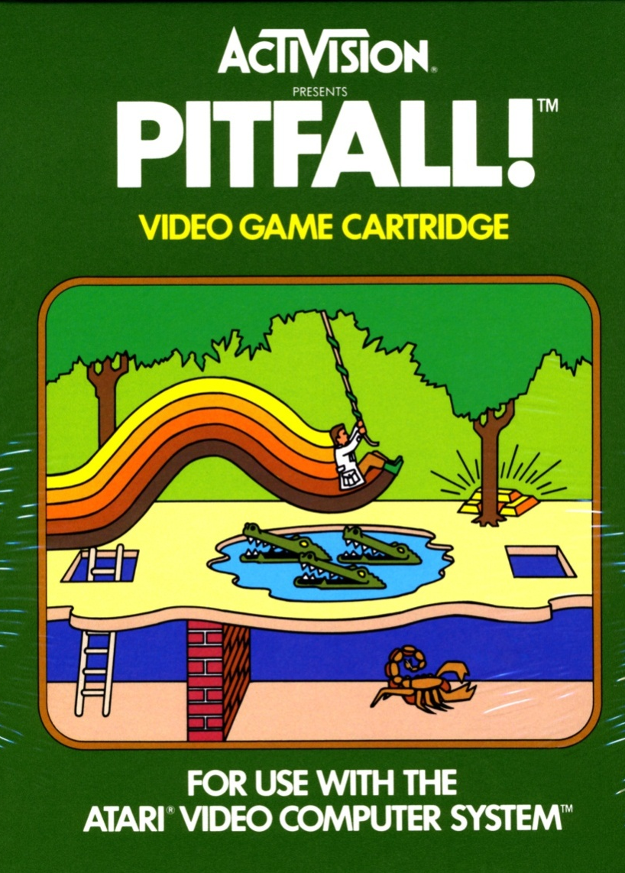
Pitfalls and pratfalls
A growing percentage of people between the ages of 18 to 29 do not know how to use basic computer technology
Practical problems with the museum database
Notes:
Both the 2010 Horizon Report and an article in the Seattle Times discuss the inability of younger people to perform basic computer functions, such as attaching documents to an e-mail. This younger population tend to be poorer and located in either inner city or rural areas. What we’re starting to see is a second digital divide, one between those who have had long exposure to computers with a full complement of software and those who have been limited to cell phones and computers lacking capabilities such as Microsoft Office and broadband connectivity. Originally, the “digital divide” referred to access to the Internet and to computer hardware; it was assumed that, if you had a computer, you were likely computer literate. That no longer holds true, as 1.3 billion people worldwide have cell phones, and data plans for cell phones targeted to low-income users have become increasingly more affordable. Today, the digital divide is about who can use computers with enough proficiency to perform basic tasks such as attaching documents to emails and deep viewing of webpages, and those who cannot.
A possible solution to this is keeping well informed docents on hand to help visitors decipher the games themselves and aid in gameplay. These “official cheat sheets” act as guides for the game as well as in their traditional role as museum guides. Because they are already trained not to be intrusive but to inform the public in ways that can enhance the viewer’s understanding of a work (a la VTS), they would be well suited to perform this role.
A more pressing issue that affects a number of museums is the lack of good technical support within museums. The DIA currently does not have a database manager on site, and other museums I have spoken with also state that their internal databases either do not contain a complete record of their holdings, include uncorrected errors or are simply out of date. This practical problem limits how data from the museum collection can be streamed into the game itself. In a perfect world, the game would be reflective of the collection, and the Room of Wonders game illustrates perfectly how a museum database can be used to enhance gameplay. A limited database can hinder the possibilities for game development and inhibit the potential for further game incorporation.
Just because it’s a game doesn’t mean it can’t be meaningful. Games have to make sense, and they have to present enough information to help lead visitors to accurate conclusions. However, I was recently made aware that the meanings people do bring to the museum may not be at all accurate or so agenda-driven that the museum’s message is subsumed. (mention dragon box in the Chinese gallery). We may wind up with frustrated gamers whose own perspectives were not validated through the game.
Games also have to be fun. No matter the content, games are intended to be entertaining as well as stimulating and informative. A game becomes a wonderful takeaway for all audiences – keep in mind that 37% of all games are over 40, and that there are more female gamers over 50 (13%) than male gamers between the ages of 11-17 (11%), and that a well-designed game can appeal to all audiences. A game that’s not fun – either a bad story, difficult or confusing gameplay or an unsatisfactory conclusion – will simply keep visitors away.
Audience development is key to understanding what we can offer and to whom. It is not necessarily true that older people are less adept at using computers, or that younger people are naturally gifted in this area.

Slide 12
Concluding thoughts
Games can provide an interactive, immersive experience that allows viewers to understand objects in an entirely new light
With planning, thought and concerned effort, museums can integrate gaming as a innovative form of outreach that can make the museum more accessible and more meaningful to a broader number of people
More research is needed to determine how visitor behavior might prove beneficial or challenging to incorporating video games, and what kind of games will work best for which audiences

Slide 13
References
New Media Consortium, 2011 Horizon Report
PGAV Destinations, “Meet the Millennials: Insights for Destination”
Eszter Hargittai, “Second-Level Digital Divide: Differences in People’s Online Skills”
Meszaros, Cheryl, “Now THAT is Evidence: Tracking Down the Evil ‘Whatever’ Interpretation”
Wolf, Mark J.P. “Genre and the Video Game”
Xbox.ign.com, “GDN 2004: Warren Spector Talks Games Narrative”
McGonigal, Jane. Reality is Broken. Penguin Press, 2011

Slide 14
References
Salen, Katie and Zimmerman, Eric. Rules of Play, 2003, MIT Press
Huizenga, Johann. Homo Ludens (Man the Player), 1938 (referenced in numerous other works)
Barr, Pippin, et. al., “Video game values: Human-computer interaction and games”, Interacting with Computers, 2007, 19: 180-195
Bogost, Ian. (January 2011) Dark Horse: The Parimutuel Future of Procedural Rhetoric Speech presented at Wayne State University, Detroit MI

